Slide 1
PLANTS AND ZOMBIES
School of Computer Science and Engineering
OBJECT-ORIENTED PROGRAMMING

Slide 2
Group members
Trần Cao Bảo Phúc ITITIU19185
Nguyễn Hà Minh Trí ITITIU19057
Nguyễn Thành Công ITITIU19088
Võ Vương Nhật Tân ITITIU19205

Slide 3
Outline
Preparation
Logical Algorithms and Functions
Methods
Result
Opening

Slide 4
Introduction
This project is based on the Object – Oriented Programming method using Python language.
Plants vs. Zombies is a tower defense and strategy video game developed and originally published by PopCap Games for Windows and OS X in May 2009, ported to consoles, handhelds, mobile devices, and remastered versions for personal computers.

Slide 5
Preparation
1. Class:
2. Object:
There are 2 main class which is called Zombies and Plants that we want to concentrate on because we are applying the Object–Oriented Programming method to it.
An object is created using the constructor of the class. This object will then be called the instance of the class. In Python, we create the instances in following manner.

Slide 6
Preparation
3. Constructor:
Each time an object is created a method is called.
That methods is named the constructor.
The constructor is created with the function init.
class Human: def __init__(self): self.legs = 2 self.arms = 2 bob = Human() print(bob.legs)

Slide 7
Preparation
#Your code here# except Exception as Bug: print("game.py:",Bug) print("Please report the bug") input("Double Press Enter to continue !!") input()
4. Error:

Slide 8
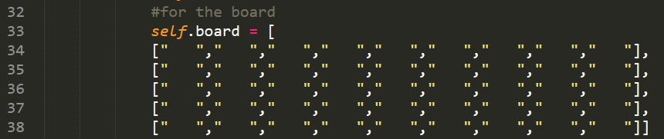
Logical Algorithms and Functions
1. Class Logic:
Board game
There is a big class named Logic. In this class, we have the constructor which contains the board of the game.

Slide 9
Logical Algorithms and Functions
Loading image:
ImgList = [] def loadResource(ImgList): num = 1 while(num <= 30): ImgList.append(pygame.image.load('Resources/blank.png')) num = num + 1 return ImgList plantImgList = loadResource(plantImgList)

Slide 10
Logical Algorithms and Functions
Mouse interaction:
Mouse click is also one the most important things that we had added to this Logic class.
We have named it Mice class.

Slide 11
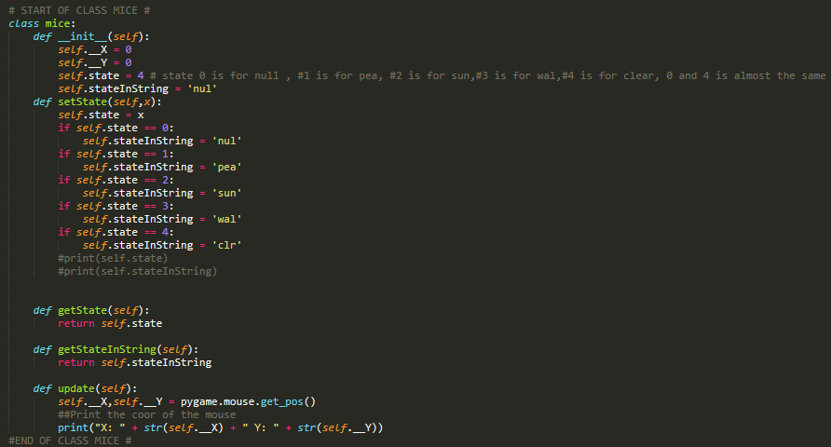

Slide 12
Logical Algorithms and Functions
2. Class Plant:
def draw(self,window): if self.health <= 300 and self.health >= 200: self.__frame = 0 elif self.health < 200 and self.health >= 100: self.__frame = 1 else: self.__frame = 2 window.blit(self.ImgList[self.__frame],(self.x,self.y))

Slide 13
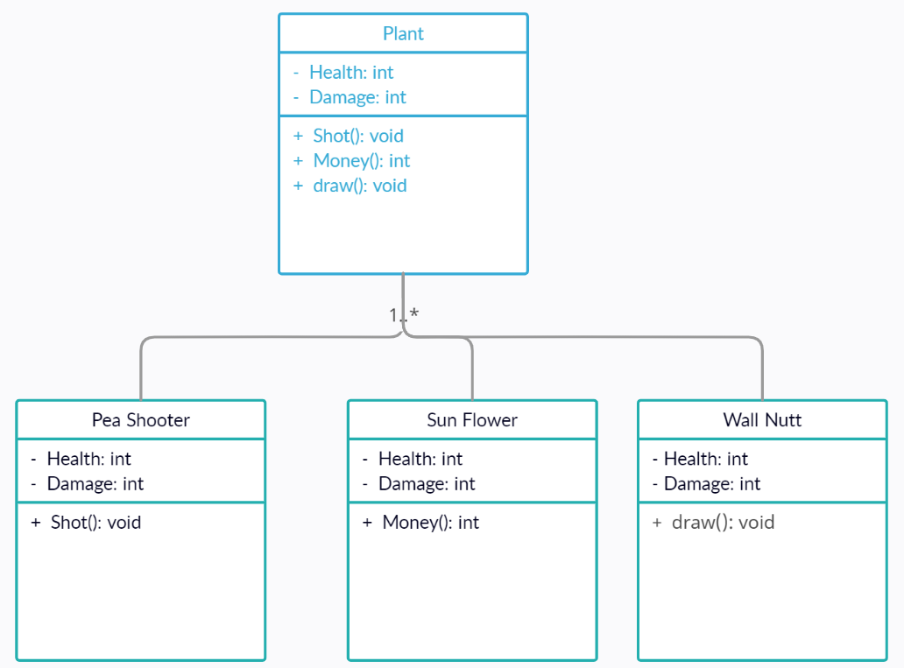

Slide 14
Logical Algorithms and Functions
1. Attacking:
2. Collision:
def attack(self,inPlant):
inPlant.health = inPlant.health - 2.5
if(inPlant.health <= 0):
self.stop = 0
def isCollide(self,inPlant):
if(self.x == inPlant.rightBorder and self.r == inPlant.r):
self.stop = 1
self.attack(inPlant)

Slide 15
Logical Algorithms and Functions
def move(self):
if self.x >= 330:
self.x = self.x - 1
3. Moving:

Slide 16
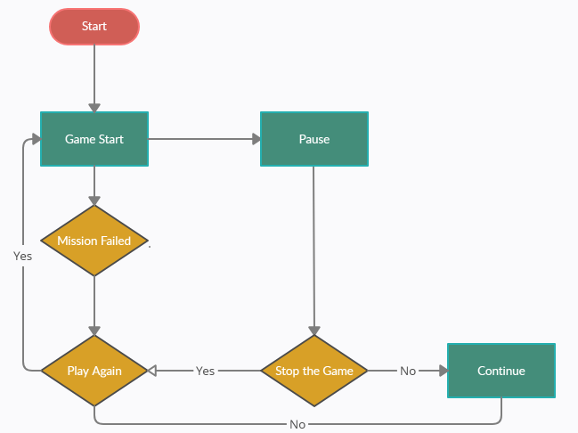
Organization

Slide 17
About the finished product
Result:
Based on the principles of The OOP Method, our project comes complete with the basic Plants & Zombies rules and properties. The association of classes and objects in the system is relatively logical. We have successfully implemented the same user interface requirements as the original Plants & Zombies version such as Main Menu, Pause Menu, Sun-coin, etc.

Slide 18
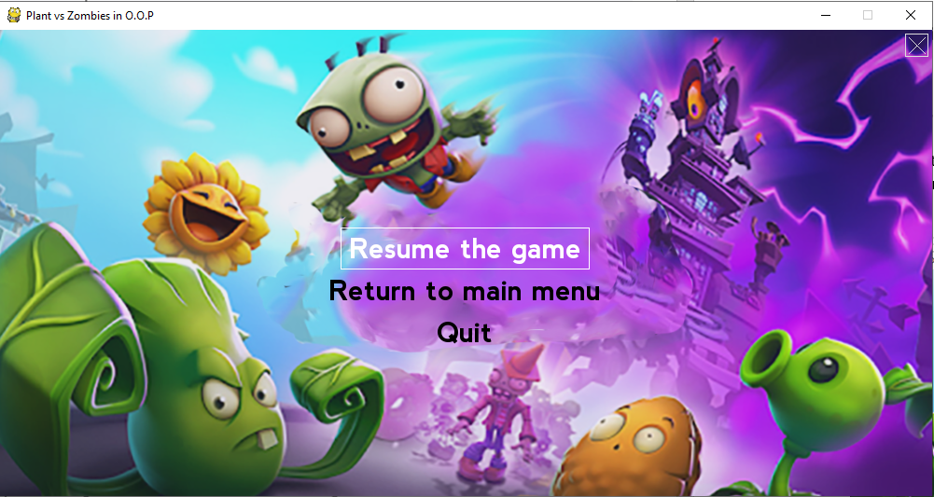
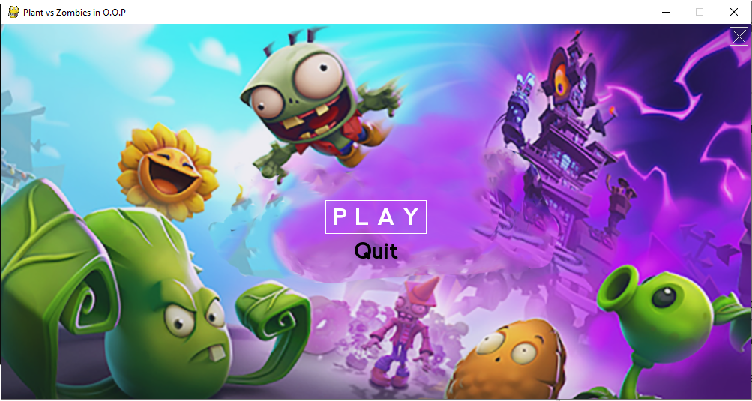
About the finished product
Pause menu:
Main menu:

Slide 19
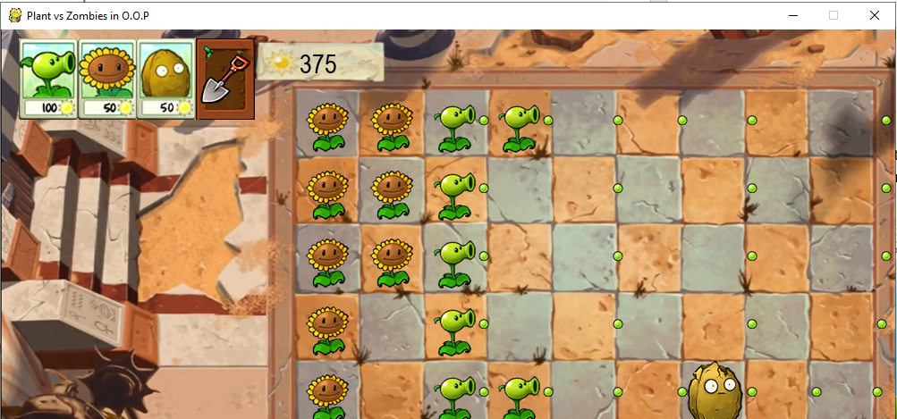
About the finished product

Slide 20
About the finished product
2. Limitations:
Do not have the sun falling down from the top of the game, player name and high score saving function.
There is only one level, we have not update new level (easy, normal, hard) and add more kind of plants and zombie.
The setting of sound is still considered, we are trying to fix the delay of bullets of Pea Shooter when there is no zombie.

Slide 21
About the finished product
3. Conclusion:
"Plants and Zombies" was built by an object-oriented method.
This shows clearly inheritance, polymorphism, encapsulation, data abstraction of OOP, and the relationship between Plants, and Zombies are linked tightly and systematically. Besides that, acquiring a lot of knowledge outside the course is one of the important things in the process of making "Plants & Zombies".

Slide 22
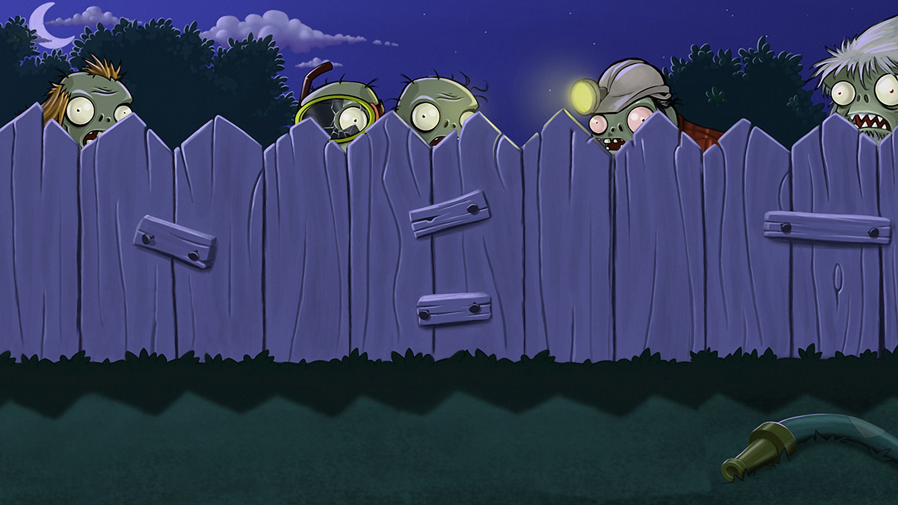
Thank you for your attention!

